Slide 1


BEHAVIOUR MODELING OF PHASE LOCKED LOOP USING DEEP LEARNING
Supervisor, Dr.S.Jana, Professor.
Batch members,
M.Shanmukha Mani(VTU20467)
L.Pavan Kumar Reddy(VTU20456)
P.Sushi Rekha(VTU20771)

Slide 2
ABSTRACT
Phase-Locked Loops (PLLs) serve as critical components in various communication systems, ensuring coherent signal reception and transmission.
Traditional PLL design relies on mathematical models, which may not capture all nuances of real-world behaviour.
By leveraging the expressive power of deep neural networks and accurate, flexible models is proposed .
Through extensive simulations and experimental validation, the effectiveness of our proposed deep learning-based approach in accurately predicting PLL behaviour across a range of operating conditions.

Slide 3
INTRODUCTION
Phase-Locked Loops (PLLs) are critical components in communication systems, ensuring signal integrity and synchronization.
Traditional PLL design relies on mathmatical models, which may not fully capture real-world behaviours
By harnessing deep neural networks, the aim is to develop precise models capable of representing PLL dynamics comprehensively.
Deep learning is proposed as a solution to overcome these challenges.
The goal is to enhance PLL design and analysis within modern communication systems.

Slide 4
Literature Survey /Review
 | TITLE | AUTHOR | TECHNIQUE USED | INFERENCE
 | Automatic mixed-signal behavioral model generation environment | Hsin-Chu City, Taiwan | Behaviour model, Deep learning | The proposed model generation environment does generate the corresponding behavioral models automatically with good accuracy.
 | Behavioral Modeling of Phase-Locked Loops for RF Systems | R. van Langevelde | Microwave Theory and Techniques | Focusing on RF (Radio Frequency) systems, this paper addresses the challenges of behavioral modeling of PLLs in high- frequency applications.
 | Behavioral Modeling of Phase-Locked Loops Using a New All-Pole Structure | Thomas H. Lee and Richard S. Newcomb` | Circuits and Systems, Analog and Digital Signal Processing | The proposed model offers advantages in terms of simplicity, stability, and accuracy compared to existing models.

Slide 5
OBJECTIVE
Construct deep learning models specifically for behavioural modelling of Phase Locked Loops (PLLs) & Create models that effectively capture the dynamic behaviours inherent in PLLs.
Improve the accuracy of PLL behavioural modelling by capitalizing the capabilities of deep learning techniques.
Create models that are flexible and adaptable to various operating conditions and scenarios

Slide 6
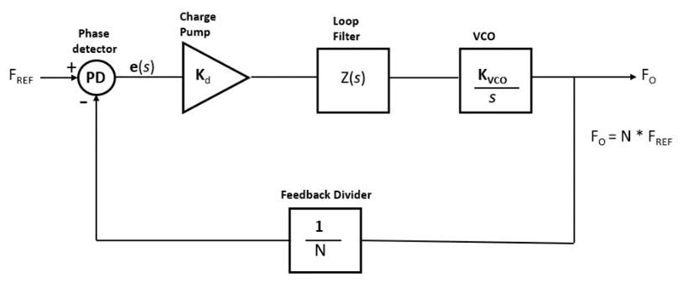
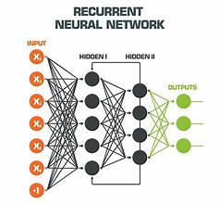
BLOCK DIAGRAM
Block Diagram of Phase Locked Loop
RNN Model Block Diagram

Slide 7
Methodology
1. Data Collection:
Gather a diverse dataset of PLL behaviours under different operating wide range of input parameters such as frequency, phase, and loop filter
conditions.Include a characteristics.
Data Preprocessing: Normalize the collected data to ensure consistency and facilitate model training. Split the dataset into training, validation, and testing sets to evaluate model performance effectively.
Model Architecture Selection: Explore various deep learning architectures suitable for sequence modeling and time-series prediction tasks. Consider recurrent neural networks (RNNs), long short-term memory networks (LSTMs), or transformer-based architectures.
Feature Representation: Define appropriate input features representing the state and dynamics of the PLL system. with different feature representations such as time-domain signals, frequency-domain characteristics, and phase noise profiles.

Slide 8
Methodology
Model Training: Train the selected deep learning model using the prepared data set. Utilize appropriate
loss functions and optimization techniques to minimize prediction errors and improve convergence.
Hyperparameter Tuning: Optimize hyperparameters such as learning rate, batch size, and network architecture to enhance model performance. Employ techniques like grid search or random search to efficiently explore the hyperparameter space.
Model Evaluation: Evaluate the trained model on the validation set to assess its generalization capabilities. Monitor metrics such as mean squared error, mean absolute error, and correlation coefficient to quantify model performance.
Model Validation: Validate the final model using the reserved testing set to ensure unbiased performance estimation. Compare model predictions with ground truth PLL behaviors to validate the accuracy and reliability of the model.
Analysis and Interpretation: Analyze the learned representations and internal states of the deep learning model to gain insights into the underlying PLL dynamics. Interpret the model predictions to identify potential areas for improvement in PLL design and optimization.

Slide 9
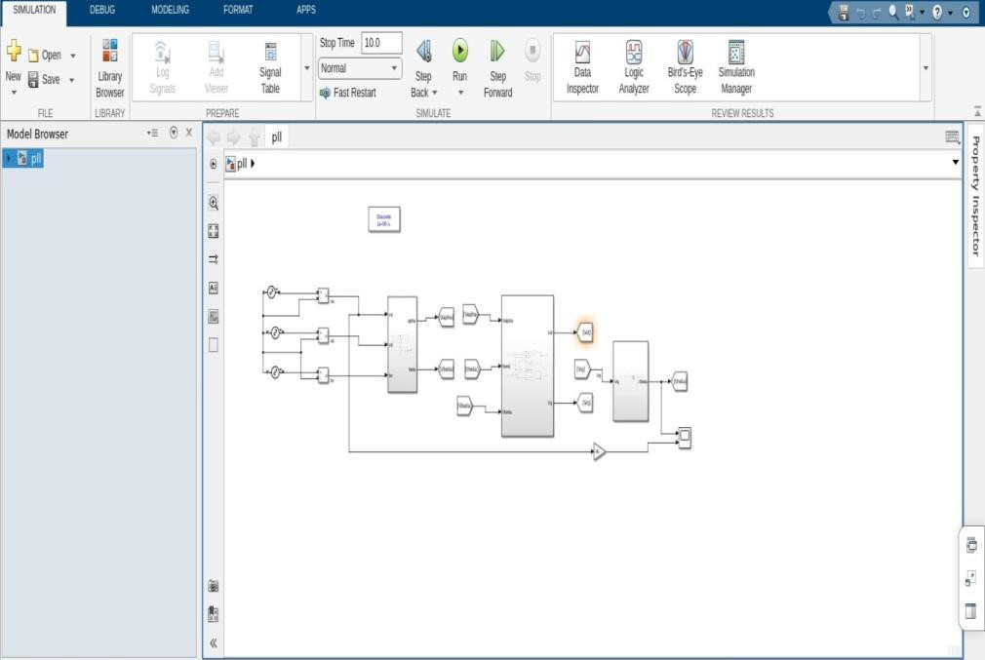
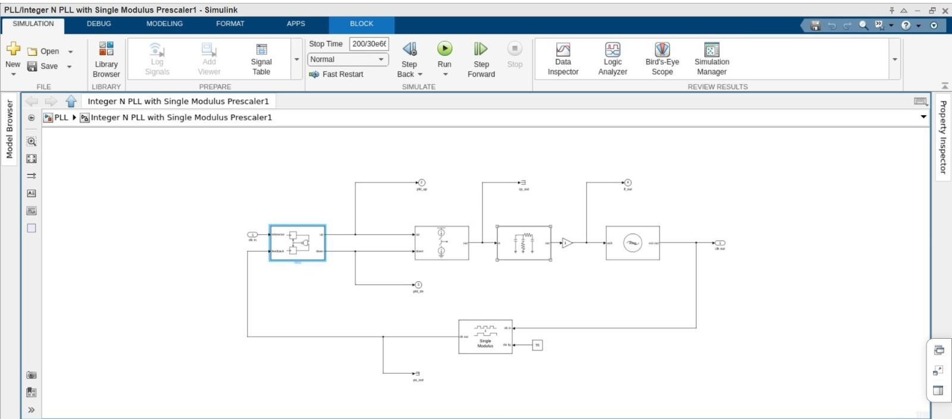
Implementation using MATLAB SIMULINK
Implementing the Phase Locked Loop using MATLAB SIMULINK
Single signal PLL
Mixed Signal PLL

Slide 10
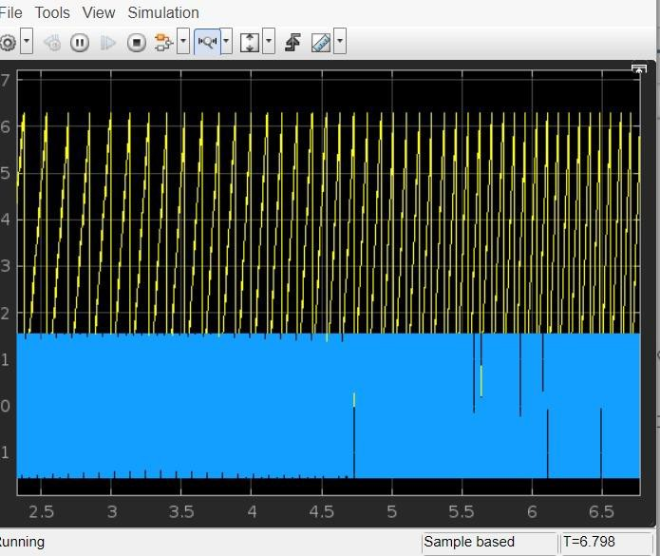
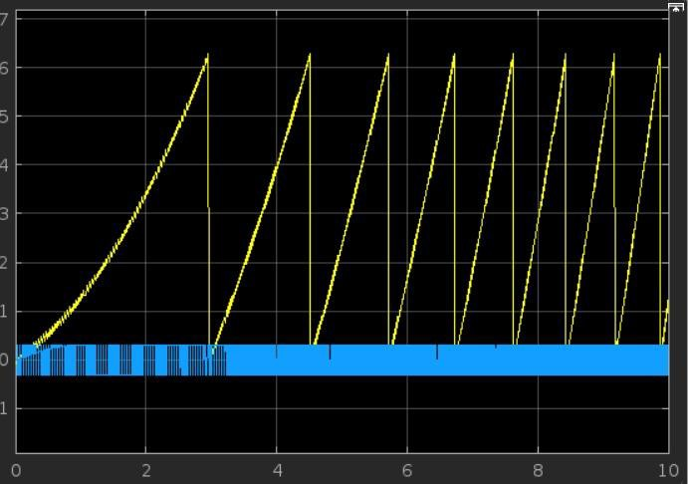
Implementation using MATLAB SIMULINK
Output of Phase Locked Loop using MATLAB SIMULINK
Output of Mixed Signal PLL
Output of Single Signal PLL `

Slide 11
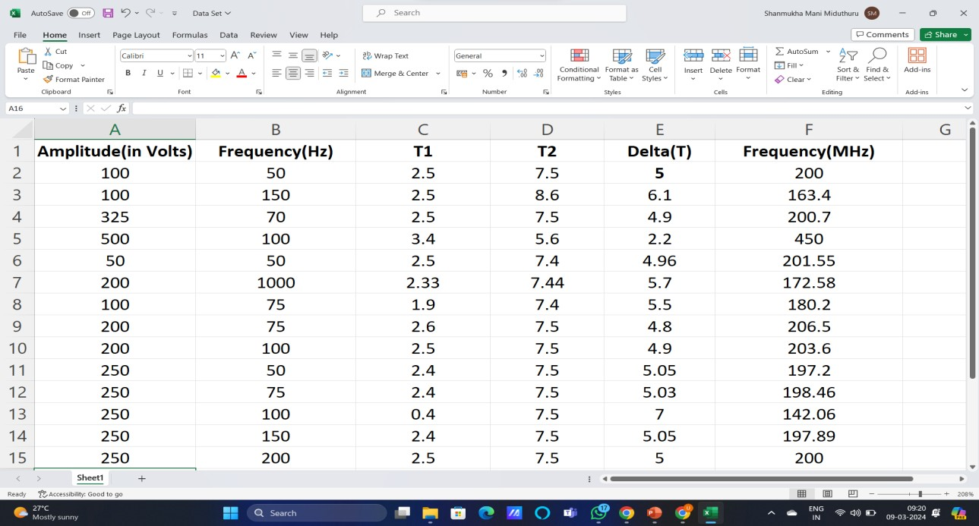
Creating a Data Set
Data Set is Used to Train RNN Network which involves Deep Learning Techniques in Behavioural Modelling of Phase locked Loop.
Data Set of output Samples with Various Inputs

Slide 12
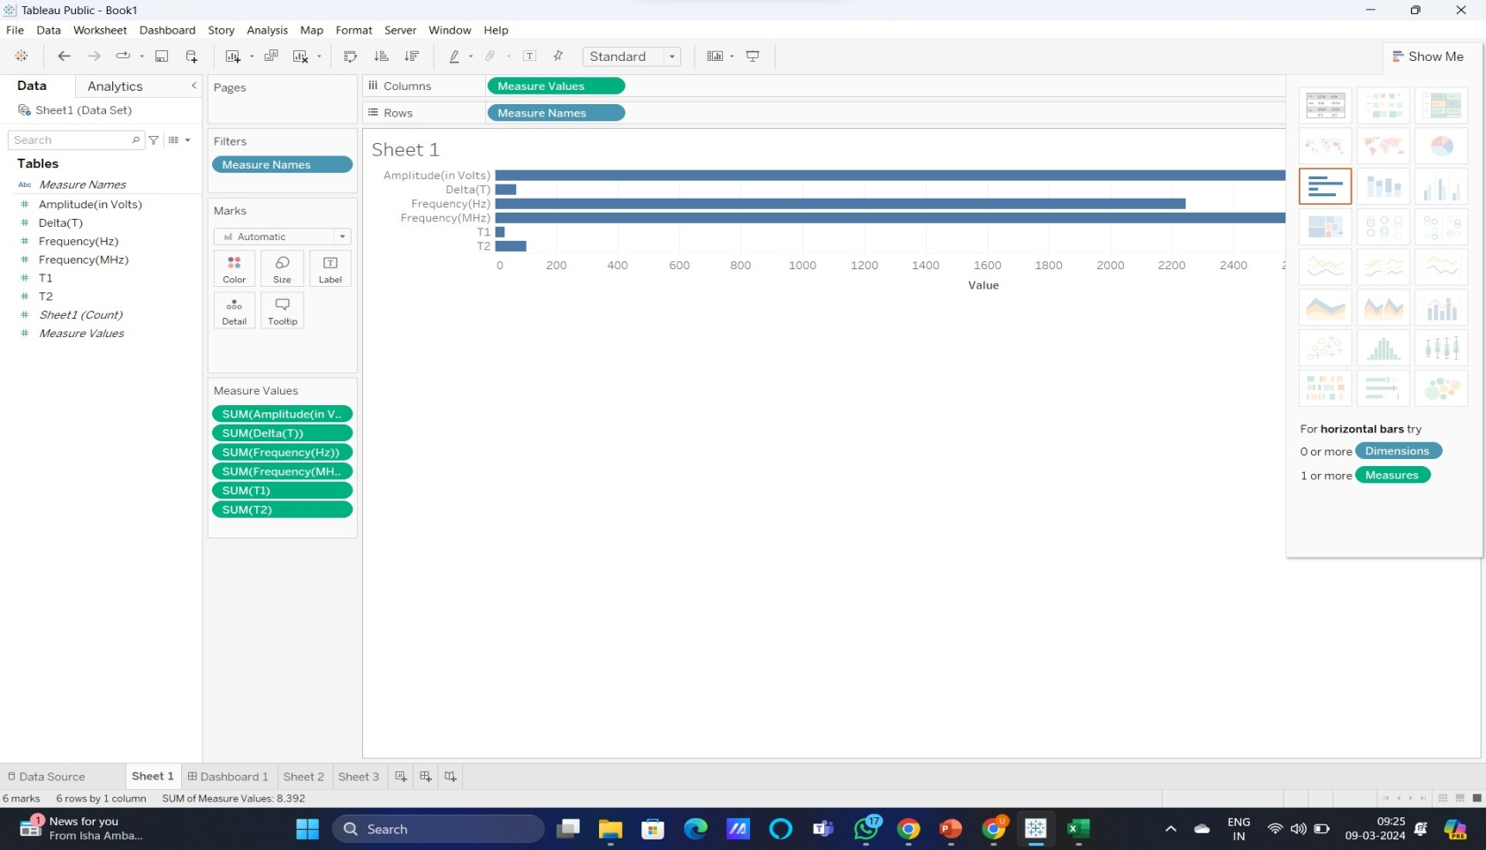
Data Visualisation of Data Set using Tableau
Input:
Amplitude(in Volts)
Frequency(in Hz)
Output:
Time T1(in sec)
Time T2(in sec)
Delta of T
Frequency(in MHz)
Data Visualizing using Tableau

Slide 13
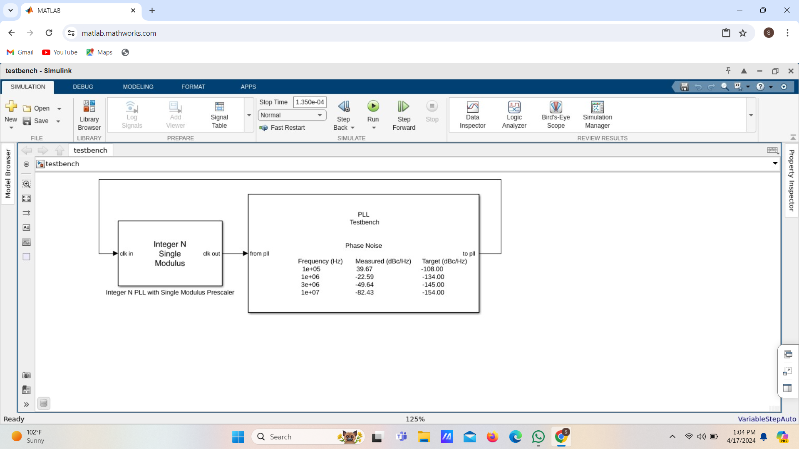
PLL Test Bench

Slide 14
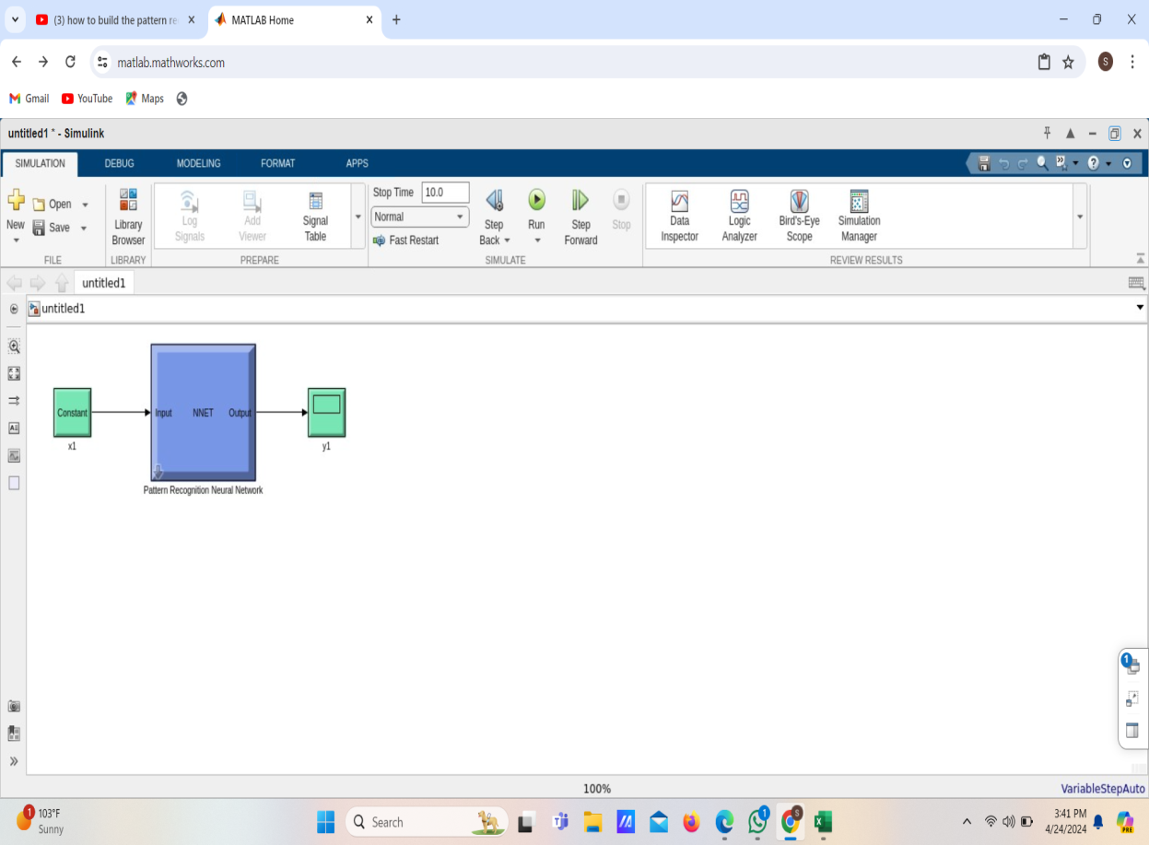
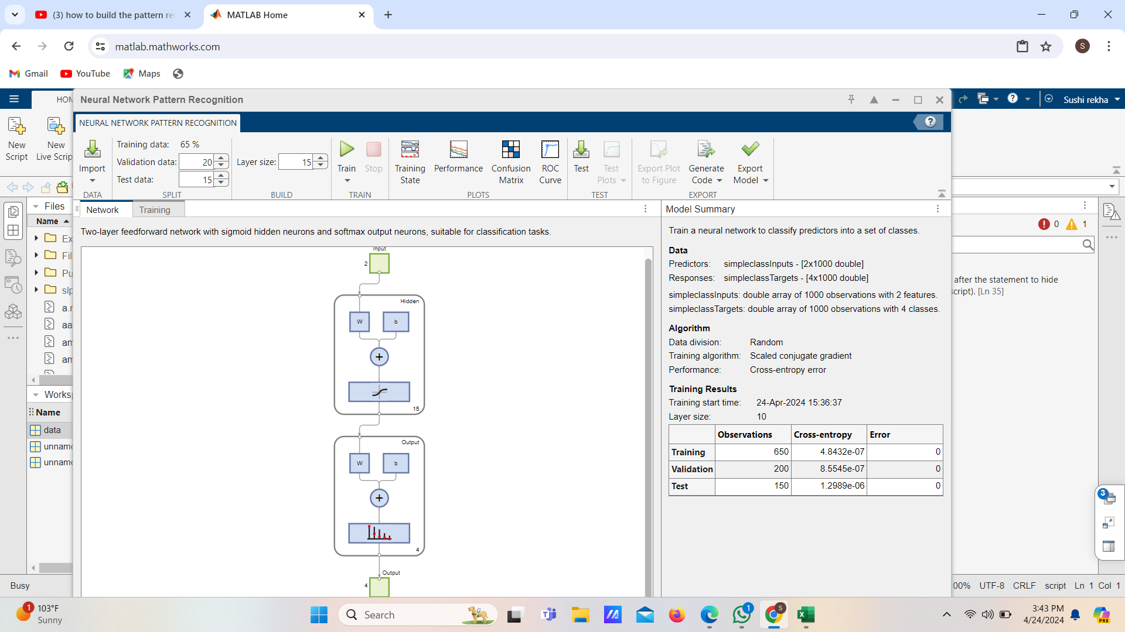
Creating a model Using Deep Learning Tool Box
Pattern Recognization Using Deep learning tool box
RNN Model

Slide 15
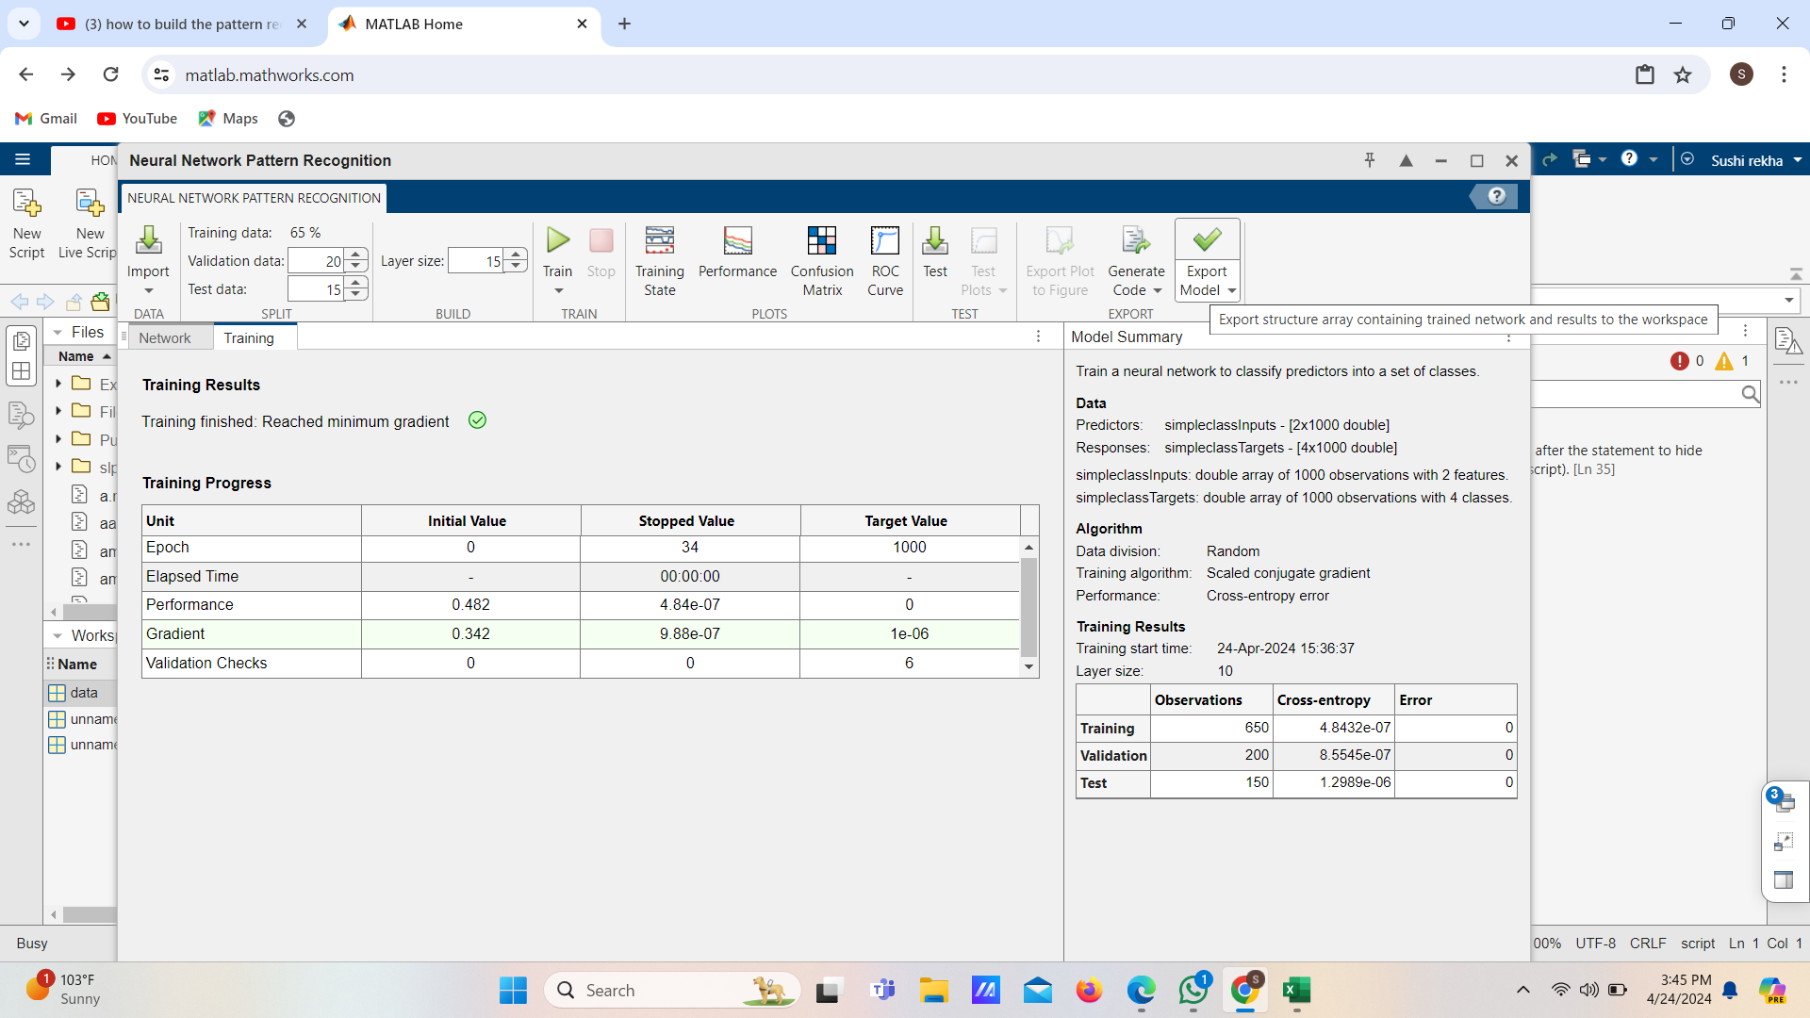
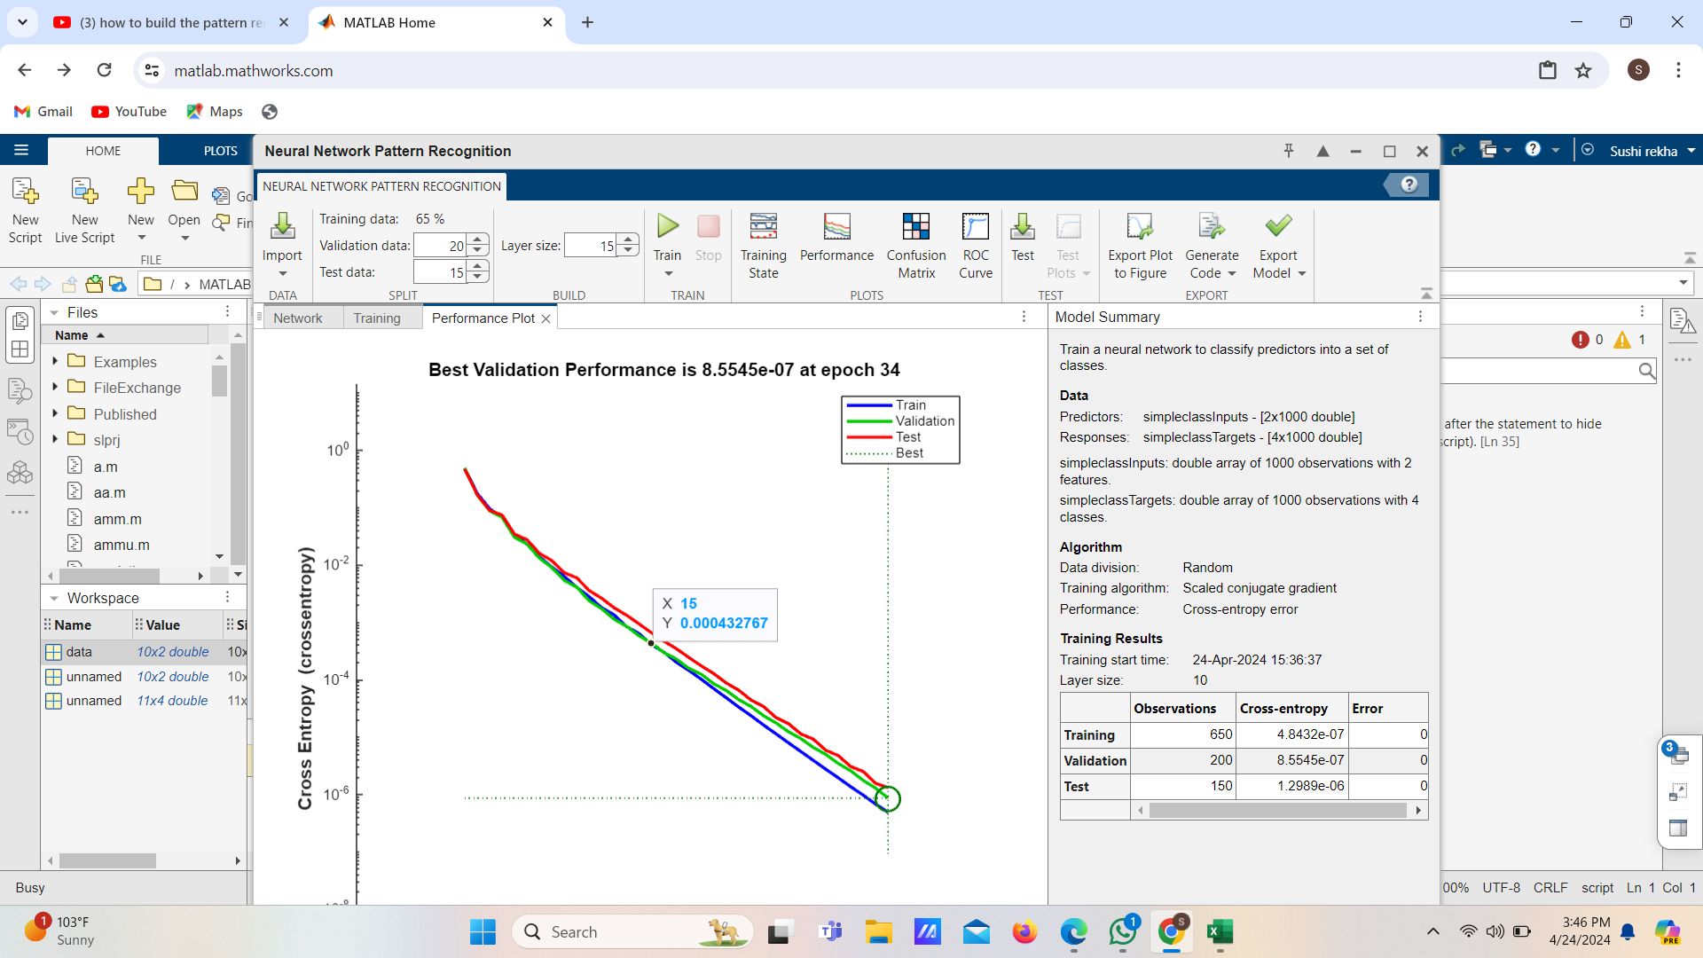
Model Validation Output
Test Output
Output Graph

Slide 16
Timeline Plan
Completed | Week 1 | Searching Various Project Statement
 | Week 2 | Finding General Information
 | Week 3 | Understanding Various Base Papers Regarding The title
 | Week 4 | Describing the Idea for the problem Statement
 | Week 5 | Aquiring Knowledge and Overview of the project
 | Week 6 | Implementing The Basic Steps of Project
 | Week 7 | Completing the module 1 and describing the output
 | Week 8 | Implementing Module 2 based on the output of module 1
 | Week 9 | Execution of Project
 | Week 10 | Describing The Output and testing the project
 | Week 11 | Preparing the report from the output
 | Week 12 | Preparing for final Review

Slide 17
References
Razavi, Behzad. RF Microelectronics. Upper Saddle River, NJ: Prentice Hall PTR, 1998.
Banerjee, Dean. PLL Performance, Simulation and Design. Indianapolis, IN: Dog Ear Publishing, 2006.
B. Khailany et al., "Accelerating Chip Design With Machine Learning," in IEEE Micro, vol. 40, no. 6,
pp. 23-32, 1 Nov.-Dec. 2020, doi: 10.1109/MM.2020.3026231.

Slide 18
THANK YOU

